Slide 1
Resume Parser
J-Component
CSE4022- Natural Language Processing Review-3
By-
Sheral Simon Waskar 20BCE1182
Anjali Jain 20BCE1320
Rahul Sunov 20BCE1424
Faculty: Dr. Ilakiyaselvan N

Slide 2
PROBLEM STATEMENT:
The problem statement is to precisely extract crucial information from resumes, classify them in accordance with job requirements, and minimize the time and effort needed to examine resumes. This enables organisations to properly and rapidly screen resumes and enhance the recruiting process.

Slide 3
LITERATURE:
A significant number of fresh job seekers with a variety of resumes must be dealt with by agencies and various high-level organizations. It is more difficult and time-consuming to manage vast amounts of text data and choose the best option, though. This article gives a brief introduction of an ongoing project called Information Extraction System, which extracts pertinent data from resumes to assist recruiters in choosing the best applicant.
This research paper introduces a novel method for automating the process of obtaining pertinent data from a job applicant's résumé and determining the job category based on the obtained information. The system is a resume parser that extracts data from a résumé, including education, work experience, skills, and contact information, using machine learning methods.

Slide 4
OBJECTIVE:
The objective of a resume parser is to extract information from resumes, forecast the type of job, and provide an automated solution that can quickly filter a large number of resumes and correctly select the best applicants for a given position. The resume parser's particular goals are:
Can take important information from resumes—like employment history, education, and skills—and save it in a structured fashion.
To accurately anticipate the job category and classify resumes based on job requirements.
To drastically cut down on the time and effort needed to analyse resumes in order to increase the effectiveness and efficiency of the screening process.
To eliminate hiring prejudice by offering a consistent, impartial method of reviewing applicants.
To highlight areas for improvement and offer insights into the effectiveness of job matching.
To enhance the resume parser's functionality for various job categories and languages.

Slide 5
DATASET
https://drive.google.com/file/d/12NOPYYD-PaW6MKAAVPsYoUlzzcDyOO-l/view?usp=share_link

Slide 6
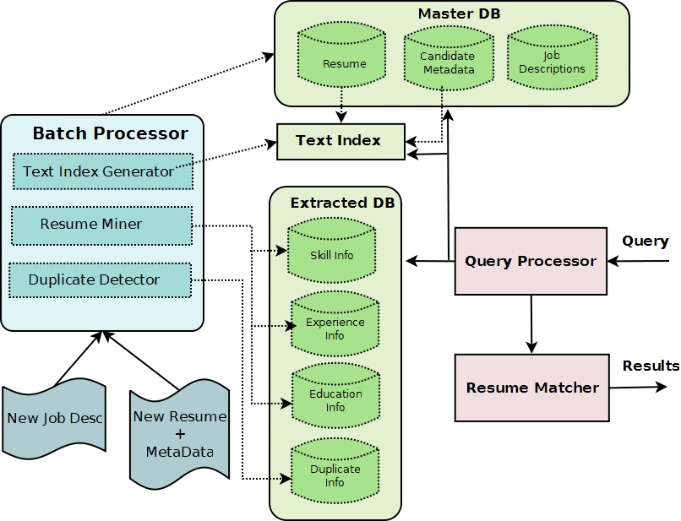
METHOD

Slide 7
ALGORITHMS TO BE USED:
NLP
Naive Bayes
Named Entity Recognition (NER)
Support Vector Machines (SVM)
Decision Tree
Random Forest

Slide 8
NOVELTY /FINDINGS
The following are some of the novelties of our project:
A resume parser can be tailored to several job categories and industries, which enables it to properly anticipate the job category and retrieve work-specific information.
Approaches for artificial intelligence and machine learning: A resume parser can utilise these approaches to increase accuracy and efficiency, enabling it to manage a huge volume of resumes and find the best candidates for a given job.
A resume parser may continuously learn from fresh information and user feedback, which enables it to enhance its performance and accuracy over time.
Integration with other HR tools: A resume parser can work seamlessly with other HR tools, such as applicant tracking systems (ATS), to speed up the hiring procedure and give candidates and recruiters a positive hiring experience.

Slide 9
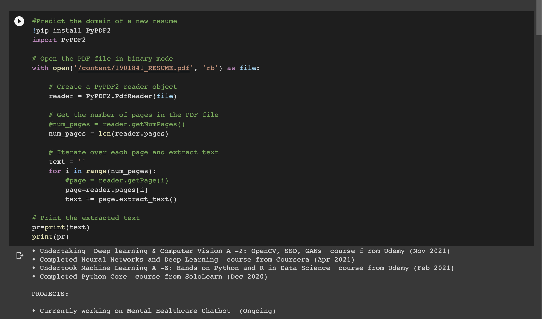
SAMPLE CODE

Slide 10
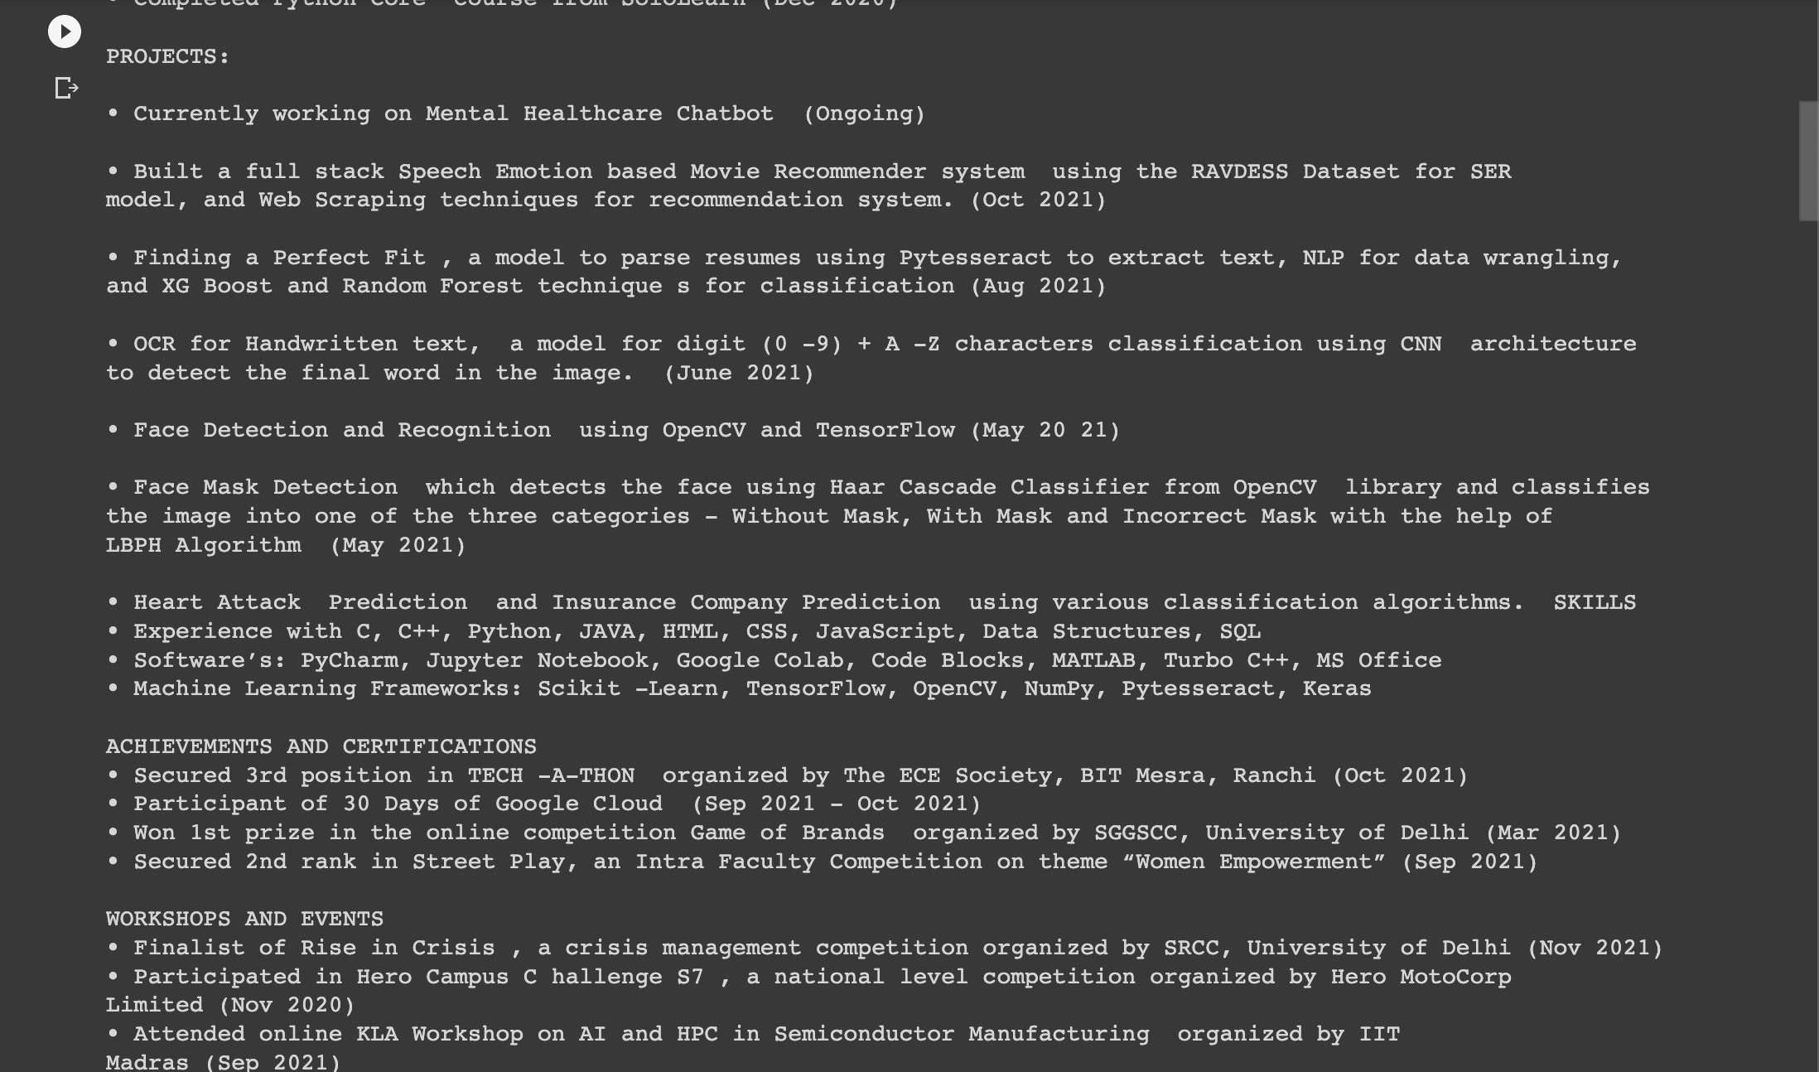

Slide 11
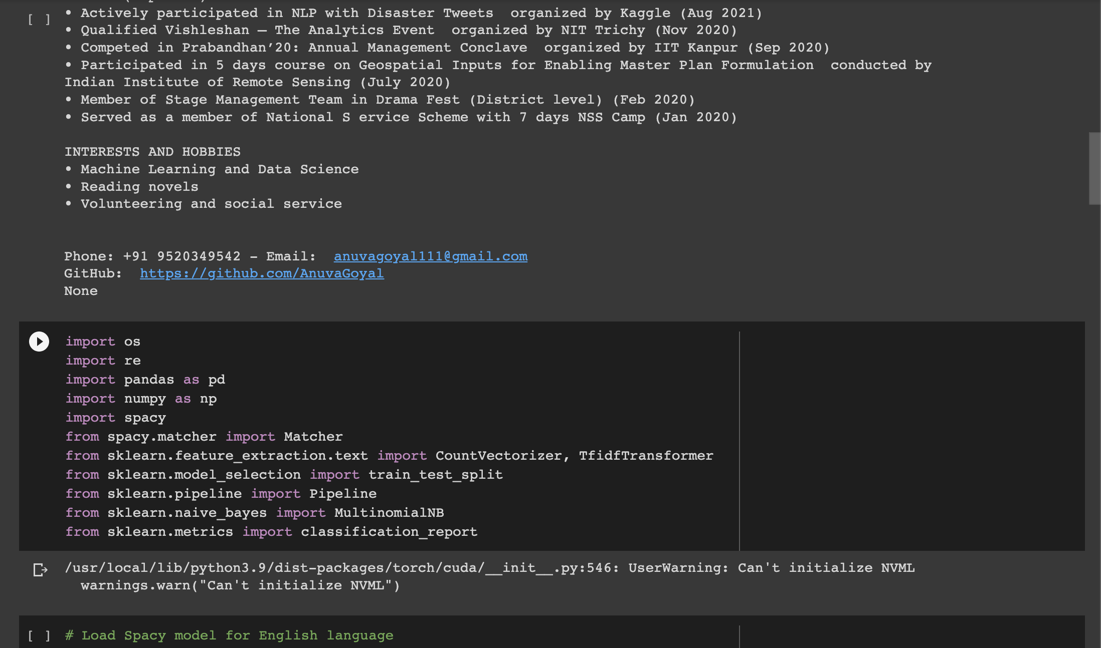

Slide 12
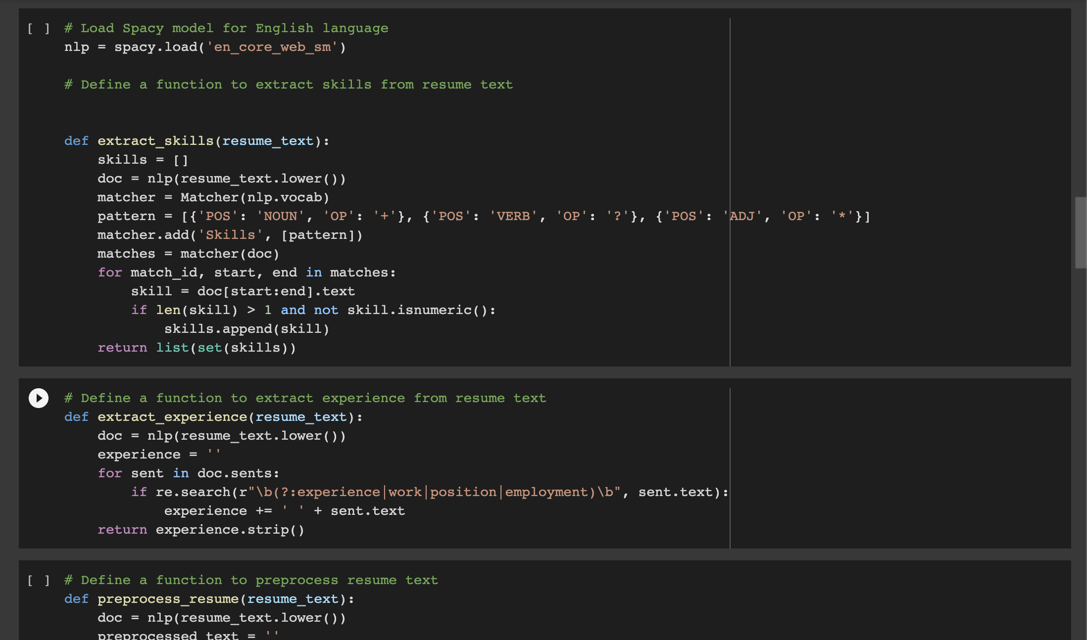

Slide 13
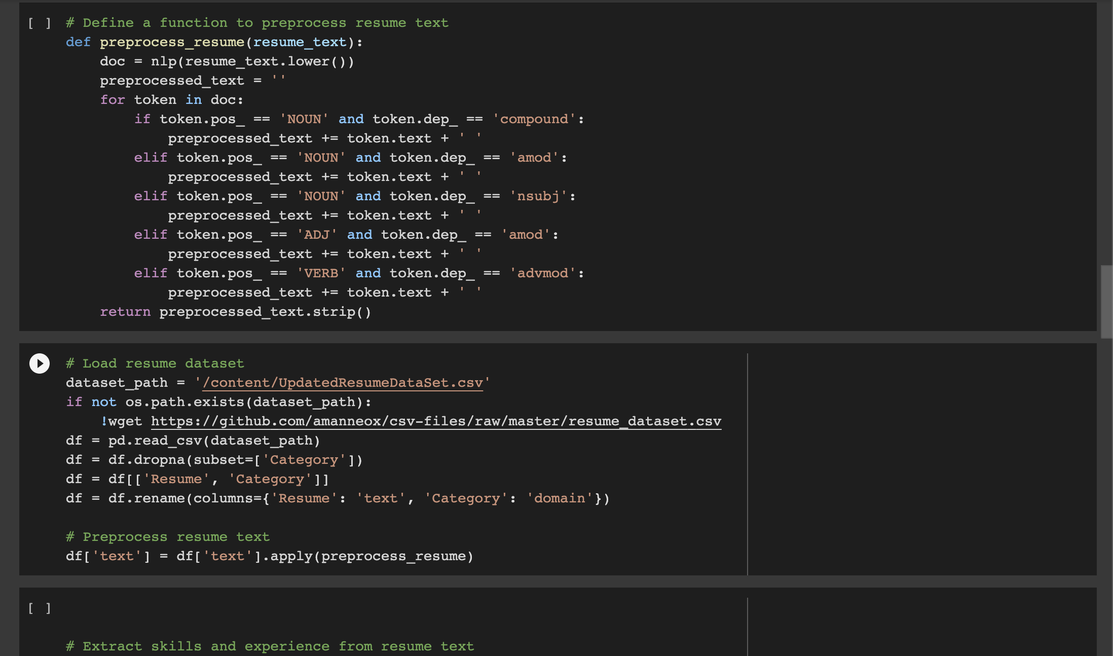

Slide 14
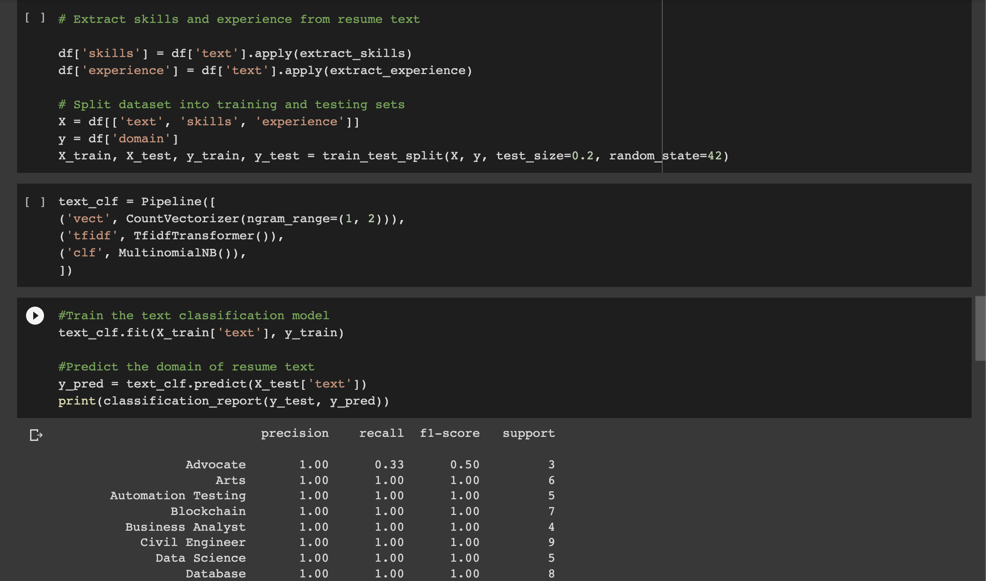

Slide 15
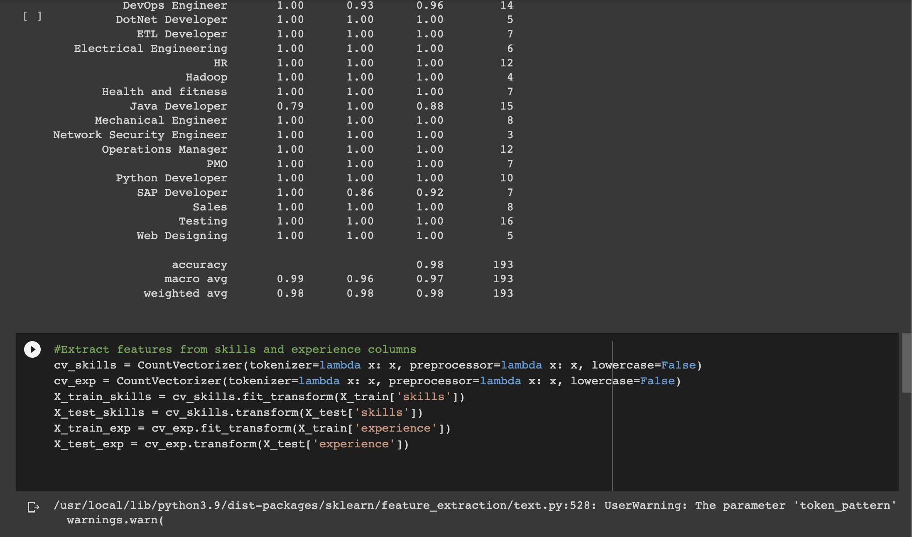

Slide 16
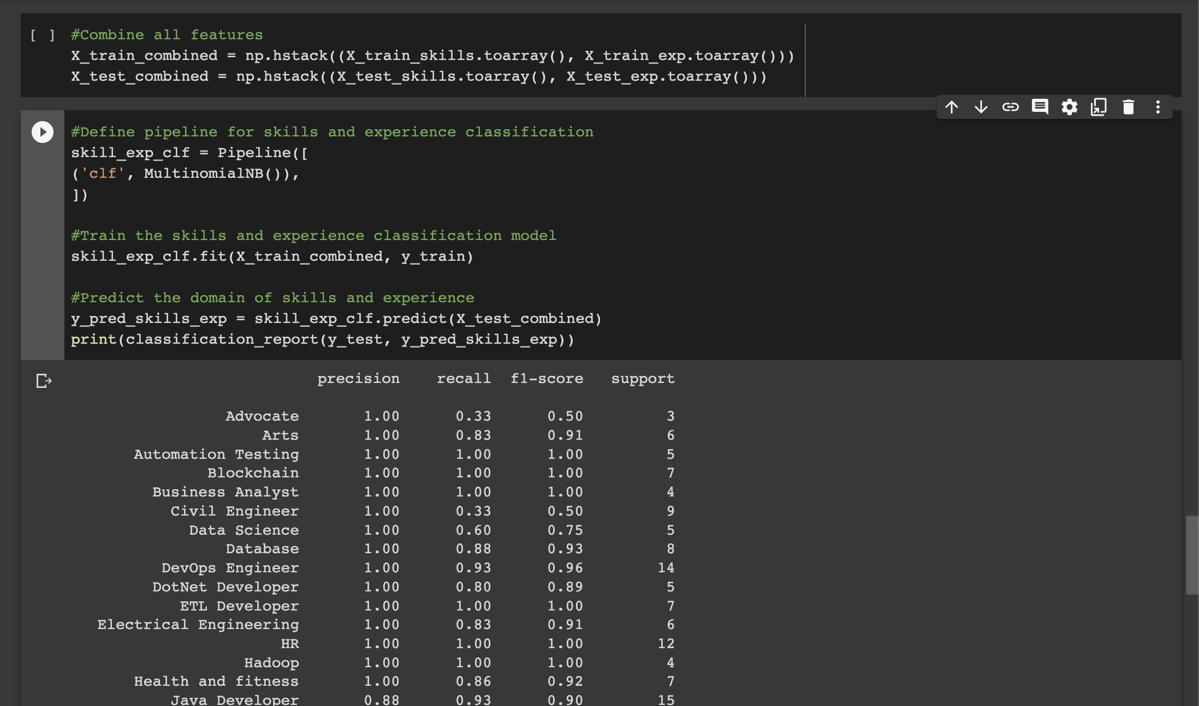

Slide 17
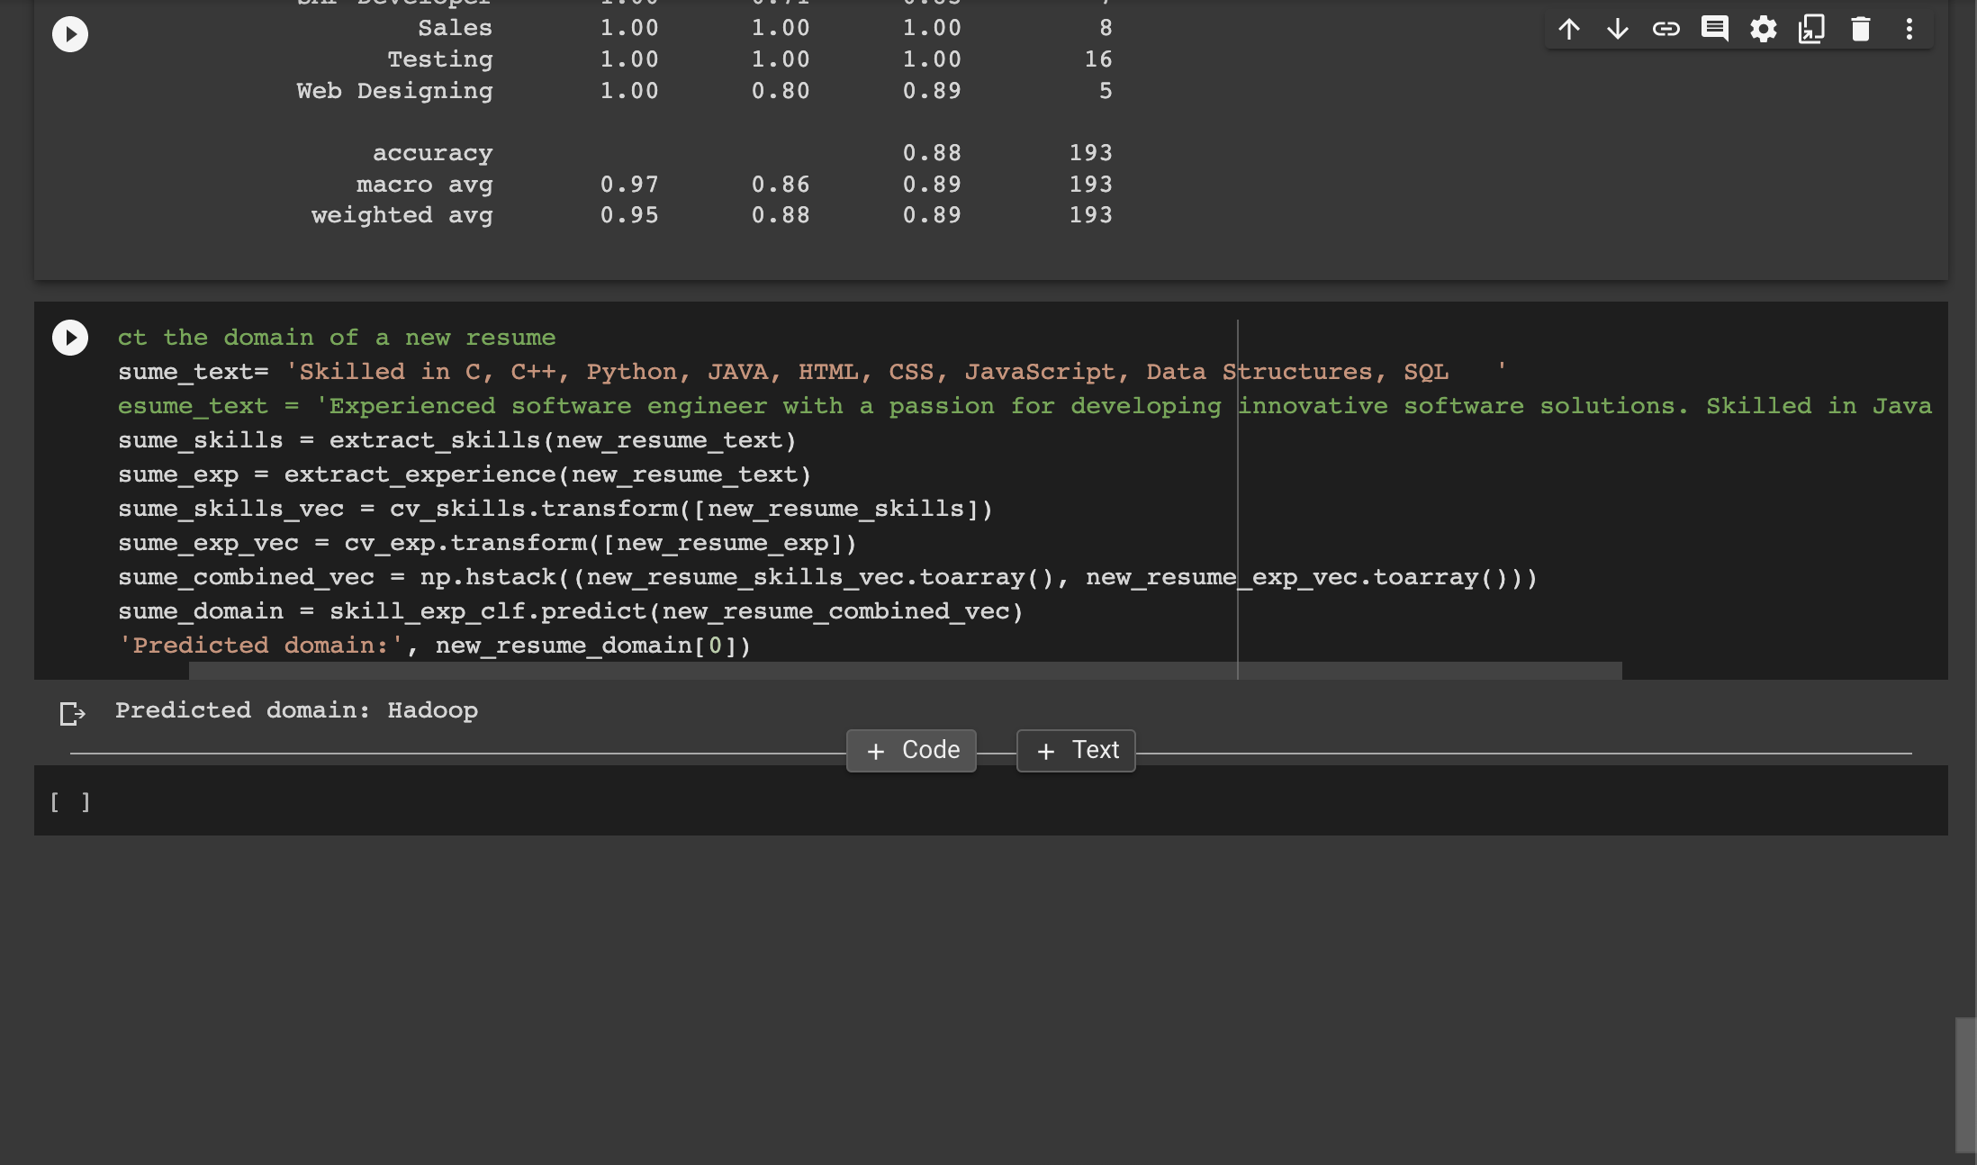

Slide 18
FUTURE WORK
Finalizing and applying the various algorithms and finding the best out of them
Completing the Project
Further scope of the project

Slide 19
CONCLUSION:
Our project suggests a system for automatically parsing resumes and determining the job category using machine learning techniques. Our project emphasises the advantages of the suggested architecture, such as enhancing job matching effectiveness, reducing hiring bias reduction, and enhancing HR department productivity. However, it acknowledges the need for high-quality training data and the potential for false positives and false negatives.
Future research can improve the architecture's performance for other job categories and languages. The research offers a viable approach to automating the resume screening procedure overall, increasing the hiring process' efficacy.

Slide 20
REFERENCE LINKS
https://www.researchgate.net/profile/Satyaki-Sanyal/publication/313851778_Resume_Parser_with_Natural_Language_Processing/links/58ab134eaca27206d9bcefd1/Resume-Parser-with-Natural-Language-Processing.pdf
https://ieeexplore.ieee.org/abstract/document/5170487
https://ieeexplore.ieee.org/abstract/document/4797321
http://jmdet.com/wp-content/uploads/2015/08/CR9.pdf
https://rakeshgunduka.me/static/assets/PublishedPaperResumeRanking.pdf

Slide 21
THANK YOU

